Slide 1




Emergency Preparedness
For Children And Youth With
Special Healthcare Needs
126 Poplar Grove Connector
Boone, NC 28607
Notes:
Welcome everyone! Talking and doing tonight! Help you get prepared should there be an emergency. Lots of wonderful sponsors but special thanks goes to Cabarrus County Innovative Approaches for supplying us with the basics for this power point….because they did this first!

Slide 2
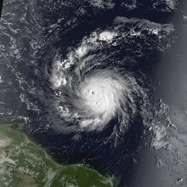
When Disaster Strikes
Notes:
Hurricane Hugo September 22, 1989 – Massive damage, power outages for weeks, no water, no way to get out of neighborhoods,

Slide 3
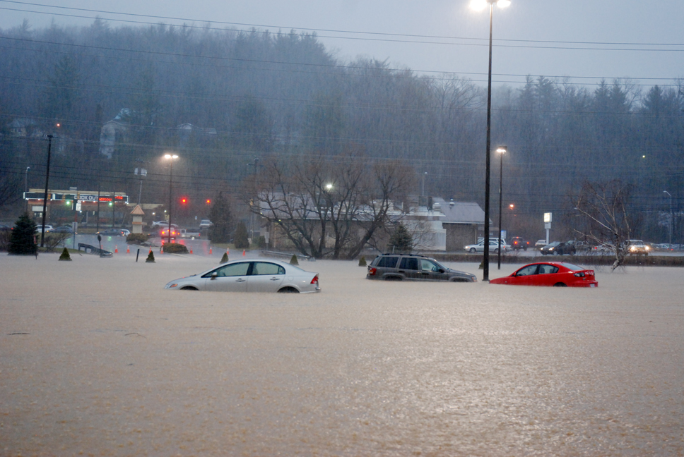
Boone Mall Flood
Notes:
We may not have hurricanes but we do get the aftermath of heavy rains…and we do sometimes get tornadoes.
Or it might mean having to evacuate on a moments notice but more likely you need to be prepare to be able to survive in your home. And you need to be prepared for 3 days. Will you be prepared?

Slide 4
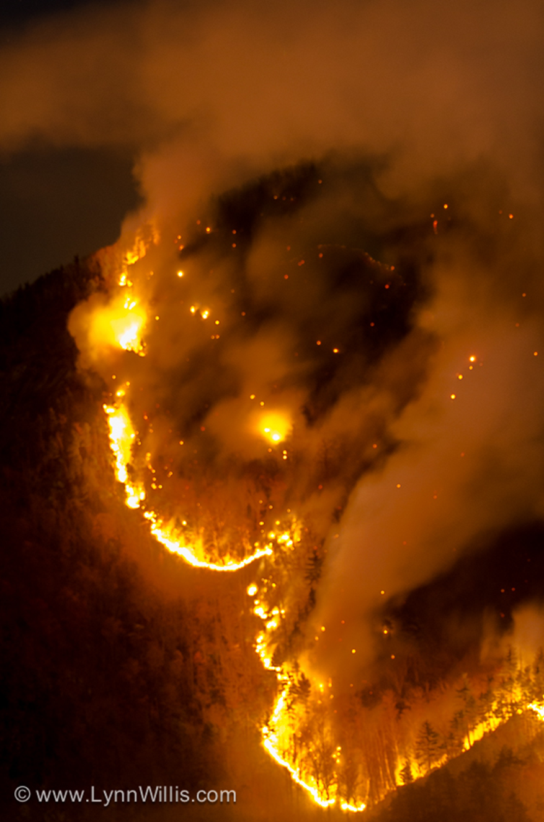
Linville Gorge Fire
Notes:
Fire is a possibility.

Slide 5
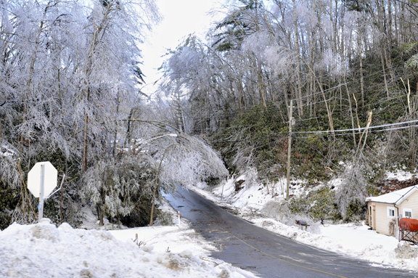
Watauga County
Notes:
But the most likely for us…. Is snow and ice….Beautiful but can leave you stranded without power or water for days/weeks

Slide 6
If Your Child or Youth….
Depends on electricity --- to breathe, be fed, stay comfortable
Cannot be moved easily because of his medical condition or attachment to equipment
Uses a wheelchair, walker, or other device to move
Cannot survive extreme temperatures, whether hot or cold
Becomes afraid or agitated when sudden changes happen
Cannot get out of an emergency by herself for physical or emotional reasons
Notes:
While we hope disasters don’t happen, ALL families should have emergency plans for their children. If your son or daughter has special health care needs, your emergency plan will probably be more complicated, involve more people, and may require equipment. This will be the case if your child or youth……. Planning how you will respond is critical. It means extra attention to details that other families don’t have to worry about.

Slide 7
Special Healthcare Needs
Complete an emergency information form
Complete a care plan form that describes your child's daily care routine
Keep a copy of these forms with your child (in a back pack or wheelchair bag) and in your child's emergency kit. Provide these forms to those who may care for your child in your absence.
Notes:
Complete an emergency information form for your child with the help of a health care provider
www.aap.org/advocacy/blankform.pdf
Complete a care plan form that describes your child's daily care routine
http://cshcn.org/download-documents
Keep a copy of these forms with your child (in a back pack or wheelchair bag) and in your child's emergency kit. Provide these forms to those who may care
for your child in your absence.

Slide 8
Medical Needs
3-day supply of medications
Make a List
Medical equipment
3-day supply medical supplies
Notes:
Epilepsy, Diabetes, Asthma, etc.
of all medications, doctor who prescribed them, and doctor’s contact information
Store the medications in one location in their original containers
For all medical equipment requiring power – beds, breathing equipment, or infusion pumps - check with your medical supply company for back-up power source, such as a battery or generator
such as bandages, ostomy bags, or syringes
If your child uses oxygen, have at least a 3-day emergency supply as well as a 3-day supply of tubing, solutions, and medications, etc. Secure oxygen tanks so they do not fall over.

Slide 9
Special Nutritional Needs
2-week supply of an special formula and medications
Know how to measure formula
Rotate formula and medications in your disaster kit
Back-up batteries or a generator
Have a back up of supplies
Locate other families with similar needs
Notes:
Have a two week supply of an special formula needed and water (1 gallon per person per day)
Have a two week supply of medications, both prescription and non-prescription
Rotate formula and medications in your disaster kit on a regular basis to avoid spoiling
Purchase back-up batteries or a generator to power equipment that may need electricity
Have a back up of supplies you will need to feed or care for your child (feeding bags and tubing, syringes, mic-key buttons, catheters, etc)
Locate other families in case you may need to borrow formula or supplies during an emergency situation.

Slide 10
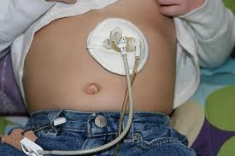
Feeding Tubes
Formula and other special medical foods
Extra tube supplies
Formula bags
Spare pump that is fully charged
Power supply that can be plugged into car
Notes:
Story about family….

Slide 11

Food Allergies
3-day supply of foods that do not require cooking
3-day supply of daily medicines
Topical medications
For latex allergies: latex- free gloves, bandages, etc.
Notes:
At least a 3-day supply of foods for your child that do not require cooking
medicines such as antihistamines, and emergency medicines such as injectable epinephrine, inhalers and other prescribed by your child’s health care provider. If your child’s allergies require compounded medicines, include them.
Topical medications such as Eczema creams

Slide 12

Autism, Down Syndrome, and other Intellectual or Developmental Disabilities
3-day supply of all your child’s medications
Make a list Copy of current IEP
Favorite toy, book, game, calming snack, portable DVD player, batteries
Be prepared for behavior changes
Medical Alert bracelets www.medicalert.org
Notes:
3-day supply of all medications, doctor who prescribed them, and doctor’s contact information
Insurance information, policy numbers, and how to contact insurance companies
Shelters should have space for sensory quiet time for children with autism
Don’t forget the batteries!!
Med alert bracelets alert emergency responders of the underlying medical conditions a patient may have - such as allergies, anaphylaxes, diabetes, and autism
Service animals may become confused, panicked, frightened or disoriented during and after a disaster. Keep them confined or securely leashed or harnessed. Be prepared to use alternative ways for your child to negotiate the environment.

Slide 13
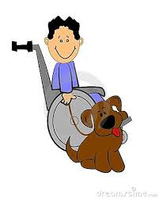
Other Things to Consider In Case of Evacuation
Wheelchairs
-Power pack/charger
-Use of manual chair
Appropriate Shelter
Notes:
What is most important? The use of the power chair or the use of a manual chair. If you must have the power chair, will you be able to use the recharger and have an appropriate supply of electricity. If it is best to use the manual chair, then the person needs to be comfortable. Perhaps you may need a spare set of good gloves. If there is an elevator, a back up plan needs to be in place. Not usually something to worry about here but maybe if you are on vacation.
Is the shelter you are going to appropriate for your needs. Can it accommodate a power chair? Are there steps to navigate? Can animals be with you? By law, a service animal can be with you but not necessarily other pets. Is there a place for the animals to relieve themselves?

Slide 14
Hearing Impairments
Store hearing aids in a strategic, consistent and secured location so they can be found and used after a disaster
Extra batteries
Maintain TTY batteries
Extra batteries for your TTY and light phone signaler
Notes:
Store hearing aids in a strategic, consistent and secured location so they can be found and used after a disaster – on bedside table, velco to the bedpost, Hearing aids will be hard to replace immediately after a major disaster
Extra batteries for hearing aids
Determine how you will communicate if you are without hearing aids – store pen and paper in emergency kit
Maintain TTY batteries (consult your manual for information)
Extra batteries for your TTY and light phone signaler

Slide 15
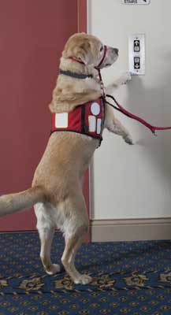
Visual Impairments
Spare cane
Mark emergency supplies with large print, fluorescent tape or Braille
Pre-printed copy of important messages
Service animals
Notes:
If used, keep a spare cane for your child in your emergency kit
Mark emergency supplies with large print, fluorescent tape or Braille
Carry a pre-printed copy of important messages such as “I speak American Sign Language and need an interpreter”
Service animals may become confused, panicked, frightened or disoriented during and after a disaster. Keep them confined or securely leashed or harnessed. Be prepared to use alternative ways for your child to negotiate the environment.

Slide 16
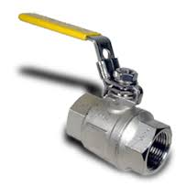

You Might Need to Shut Off Home Utilities
Where are …
The shut off valves?
Electrical panel?
Water pump?
The tools you need?
Notes:
Do you even have them? Do you know where they are located?

Slide 17
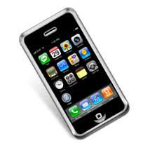
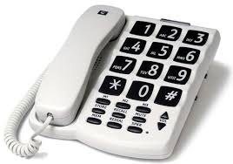
Phone Service
Cell phone
Regular phone
Contact with the outside world
Notes:
Cell phone service may be interrupted. Text messages might still work but not always. Good to have spare phone that does not require electricity to run. How will you Have contact with the outside world? Do you need email addresses or telephone numbers? We have everything in our cell phones. Can we get to that information?

Slide 18
Be Prepared
Make a Plan
Build a Kit
Be involved
Notes:
Mention EP Checklist

Slide 19
What’s in your Notebook?
Your care notebook includes an, a Pamphlet to store all of your emergency information, Emergency Quick Guide, some wonderful pages from the ECAC CareNotebook and a flash drive.

Slide 20
Emergency Pamphlet
A quick, easy and portable way to keep information you might need in emergency situations
This pamphlet can be stored in your glove box, and is a condensed and less confidential version of the Emergency Quick Guide
Update regularly or as changes are needed
A digital copy is provided on the flash drive

Slide 21
Quick Emergency Guide for Parents
A comprehensive place for all of your personal information that you might need in the event of an emergency
Be sure to keep in a secure place with other personal records
Update regularly or as changes are needed
A digital copy is provided on the flash drive

Slide 22
Pages from ECAC CareNotebook
Child’s page: A place to put information about your child (Name, Favorites, Comforter/Stressors). You can also include a picture!
Activities of Development
Coping/Stress/Tolerance
Communication
Mobility

Slide 23
Pages from ECAC CareNotebook Continued
Nutrition
Respiratory
Rest/ Sleep
Social/ Play
Some extra pages for any notes or additional comments you want to add

Slide 24

Get Organized
http://www.ecac-parentcenter.org/CareNOTEBOOK
Notes:
Keep your child’s healthcare information in 1 place and keep that information handy to grab at a moment’s notice.

Slide 25

CareNotebook Table of Contents
Frequently Used Forms
Providers and Resources
Treatment Plans and Care Summaries
Notes:
Notebook consists of 44 pages of printable information.

Slide 26
On the Flash Drive…
Entire ECAC CareNotebook
Emergency Quick Guide for Parents
Emergency Information Pamphlet
Extra space for any other forms or information you would like to add

Slide 27

Lastly…
Keep your Information Updated
Add things to you notebook
Make it your own
Find a system that works for you!
Thank You!
Notes:
When you change your batteries in your smoke alarms check your information in your notebooks! Find a system that works for you!

